Slide 1

VOLUNTEERS IN A FOOTBALL COMMUNITY

Slide 2
Agenda
1
Introduction
2
The story (The issue and challenges)
3
Our Solution - Project
4
Strategic analysis
5
Operational plan
6
Marketing plan
7
Social impact
8
Financial plan
9
Conclusion

Slide 3
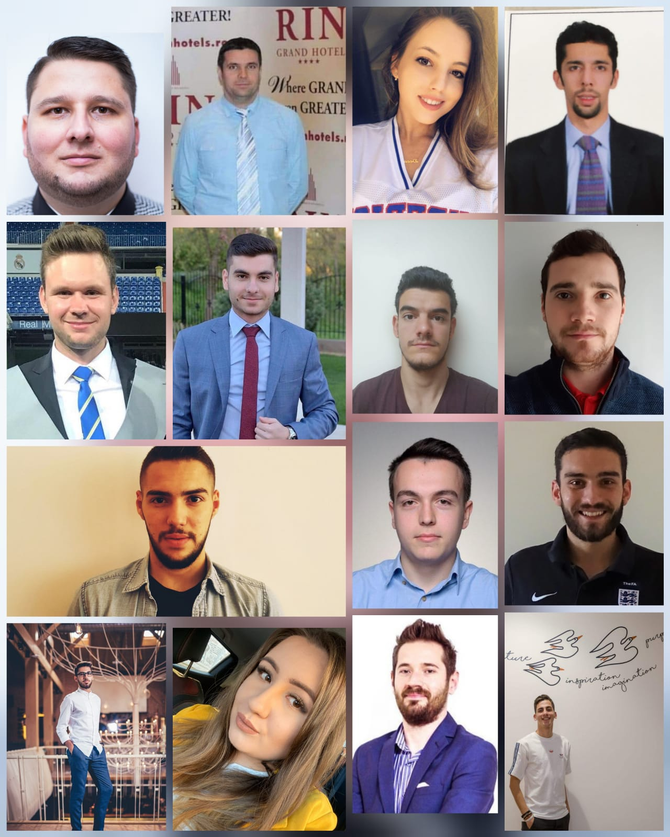
Andreea Dan, 21, Ploiești, România
Andrei-Alexandru Țone, 21, Alexandria, România
Andrei Nica, 21, Timișoara, România
Antonio Bruma, 24, Cluj, România
Cătălin Țuțuianu, 21, Târgoviște, România
Costin Felix Florea, 33, București, România
Daniel Ignat, 42, Giurgiu, România
Dragoș Căvășdan, 24, Oradea, România - living in UK
Eugeniu Procopi, 26, Chișinău, Moldova
Francisca Elena Zamfir, 24, București, România
Mihail Sebastian Lăstun, 23, Rm. Vâlcea, România
Radu Lucian Dinu, 34, București, România
Răzvan-Alexandru Dinicoiu, 24, București, România
Sharan Mehra, 31, Mumbai, India
Vlad Pîrvu, 22, Craiova, România
VoluntaRO Team

Slide 4
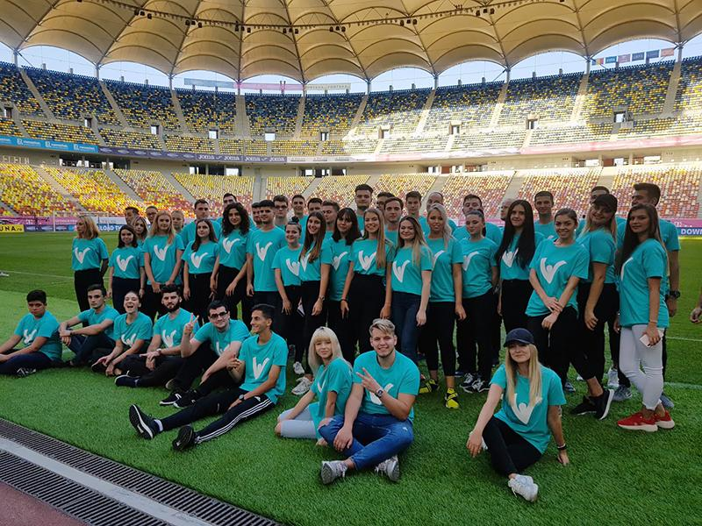
Motivational factors for volunteers
49% of volunteers declared they did it to help people/ to improve things
48% of volunteers heard from an opportunity from their friends

Slide 5
The challenge &
The opportunity
WHY (Mission): Create a Legacy!
HOW (Vision): Through education!

Slide 6

Our solution - VoluntaRO
Mission
Vision
The first platform that will help attract, develop and connect the biggest community of sports volunteers in the country!

Slide 7
Objectives
To create the biggest Romanian community of sport volunteers
Encouraging people to attend sport events
Support community development

Slide 8
Unique Selling Proposition - VoluntaRO
develops the sense of community engagement
creates future leaders
rewards the most active volunteers with exclusive access to one-of-a-kind events.
provides an opportunistic eco-system for networking

Slide 9
Strategic analysis
PEST Analysis
SWOT Analysis
Target Audience

Slide 10
PEST analysis
Political - By approval the Law of Volunteering in Romania, the Government of Romania supports volunteers movements that follows
Economical - Creating a community which will provide potential sponsors access to a very targeted audience (organic reach).
Social - A great opportunity for community engagement and trigger the feeling of contributing towards a healthier and more helpful nation.
Technological - There are few volunteer platforms for bigger cities in Romania, none to target and to connect a nation as a whole and give opportunities to everyone, in addition to being targeted to the sports volunteers.

Slide 11
SWOT analysis
Weaknesses
Small volunteer base;
Volunteer and staff burnout and turnover;
Lack of communication externally;
Volunteers have limited roles to influence.
Strengths
Volunteers:
have a passion for serving the organization;
understand the mission of the organization;
serve organizations with a history of success
are appreciated, cultivated and respected;
Administrations are generally in support of the volunteers;
In most cases, volunteers serve to their talents and strengths
are allowed freedom to perform duties within a certain structure.

Slide 12
SWOT analysis
Threats
The economy can affect volunteerism;
There is the potential other organizations can take away key volunteers from your organization;
Constant administrative changes affect volunteer program growth and progress;
Personal life changes and motivation can affect volunteers’ desires to stay involved at 100 percent commitment levels;
There may be volunteers within the same organization who are not on the same page;
Social distancing and fear of pandemic.
Opportunities
Look at best-of-class programs to emulate;
With the right staff leadership, there is the ability to express new ideas;
With the right leadership, there is the ability to recruit new subcommittee and committee members;
There is an ability for volunteers to express candid opinions about the organization’s performance from an outsider’s view;
Volunteers can make a difference by bringing their experiences and talents into play;
There is joy in seeing organizational success due to volunteer efforts;
Conduct research and bring various volunteer experiences into play to enhance organizational performance.

Slide 13

Stakeholders analysis
Ministry of Education
Ministry of Sports
Cities (city halls)
AJF
FRF & its staff
Volunteers
Other suppliers
Media
Influencers
Partners/Sponsors
NPO (UNICEF, EU etc.)

Slide 14
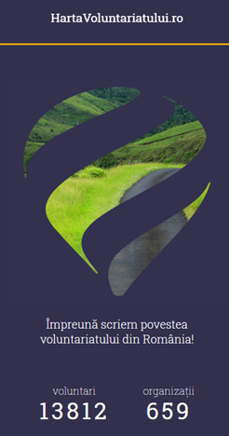
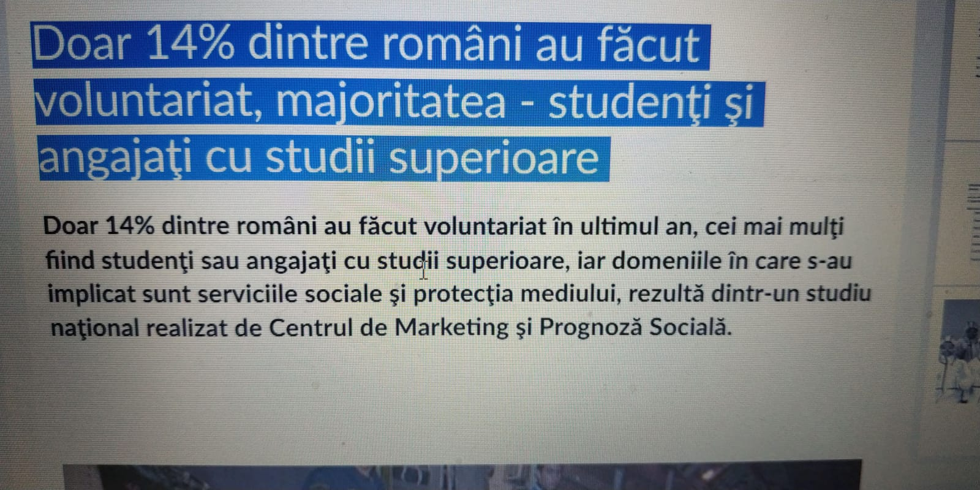
Market size - Target audience
15 % of Romanian population have tendency to volunteer. Our target audience has a poll reach of aprox. 3 million people.
1. Ages 15 - 17 ~ 1.400.000
2. Ages 18 - 35 ~ 1.200.000
3. Ages 36 + ~ 600.000

Slide 15
Legal aspects
Legal aspects regarding VoluntaRO
2. Legal aspects between VoluntaRO and public institutions (partners)
3. Legal aspects regarding VoluntaRO and volunteers:
There are allowed to use our platform volunteers of minimum 16 years old or at least 15 years old in case the parents are involved to into the same volunteering event or give them a written permission to attend other event;
Our volunteers will benefit from volunteering contract, volunteer form and volunteer protection form;
Our volunteers will receive a certificate of volunteering for all their activities;
Our volunteers will be part of VoluntaRO register of volunteering and all their rights will be respected during their activities and apart from it.

Slide 16
Legal aspects - GDPR
Art. 6 of GDPR:
Consent;
legitimate interest;
public interest.
GDPR and children
over 16;
under 16.
Security of the platform
Clauses

Slide 17
Operational Plan
In-house
1. Community admin
2. Marketing manager
3. Events manager
Outsourced
1. App development company
2. Media

Slide 18
Marketing Plan
Objectives
Pricing
Sponsorship Program
Digital strategy

Slide 19
Marketing plan
Marketing plan
Goals
2500 registrations in Year 0 (31 Dec.2020).
15000 registrations by Year 3.
Min. 10% - disabled volunteers.
Retention rate:
75%+ (volunteers to get involved in 2 or more events per year).
50%+ (more than 5 events per year)
90%+ satisfaction rate (post-events surveys)
Pricing
1. Local FAs and 1, 2, 3 League Teams (as of year 1)
AJF - 100 euro/year (42 units)
Liga 3 teams - 50 euro/year (80 teams)
Liga 2 teams - 100 euro/year (20 teams)
Liga 1 teams - 200 euro/year (16 teams)
Other sports organizations (as of Year 2)
100 euro/event
4 types of packages for other sports:
Bronze: up to 10 events/year - 500 Euro/year
Silver: up to 25 events/year - 1000 euro/year
Gold: up to 50 events/year - 1500 euro/year
Platinum: unlimited no. events - 3000 euro/year

Slide 20

Sponsorship Program
1. Objectives: Enhance current partnerships and attract new ones, that are aligning with FRF’s mission and values and offer them a tailor-made sponsorship program.
2. Assets: Mobile App, Volunteers uniform, Sporting and Non-sporting events, Social media, Volunteers video series (highlighting the stories of the most active volunteers), MVV award (most valuable volunteer).
3. Sponsorships levels (to start of with):
V-Bronze: up to 20.000 Euro/year (in goods/services and/or financially)
V-Silver: 50.000-100.000 Euro (financially + in goods/services)
V-Gold: 100.000+ Euro (only financial)/year (official Volunteers sponsor)

Slide 21
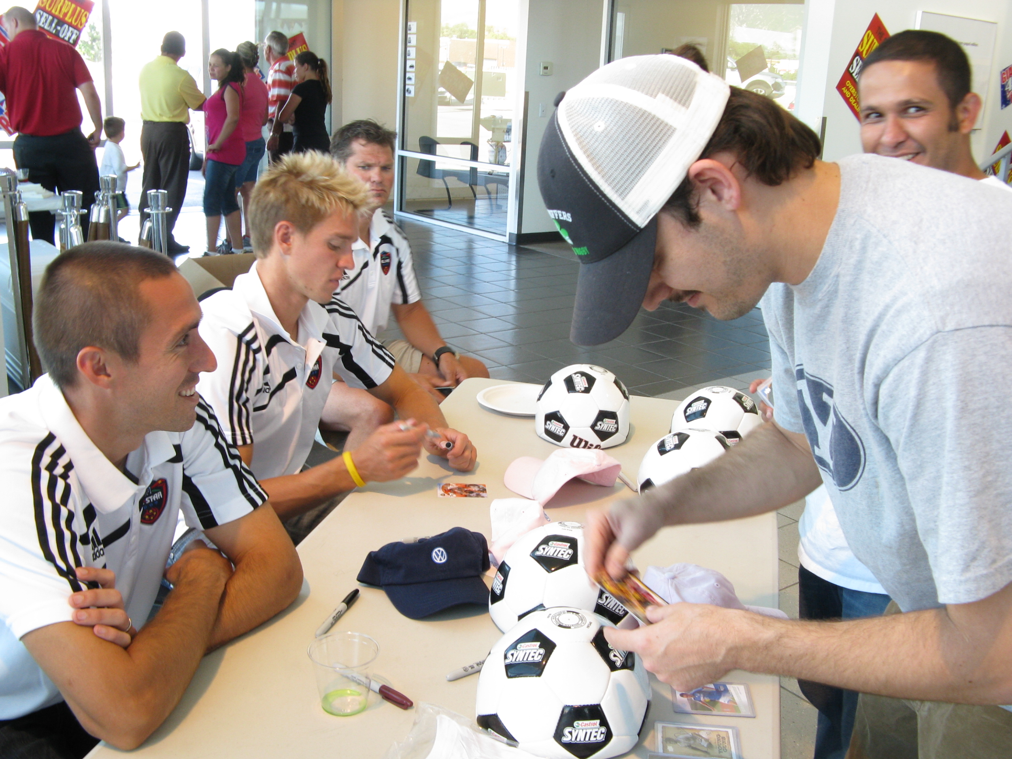
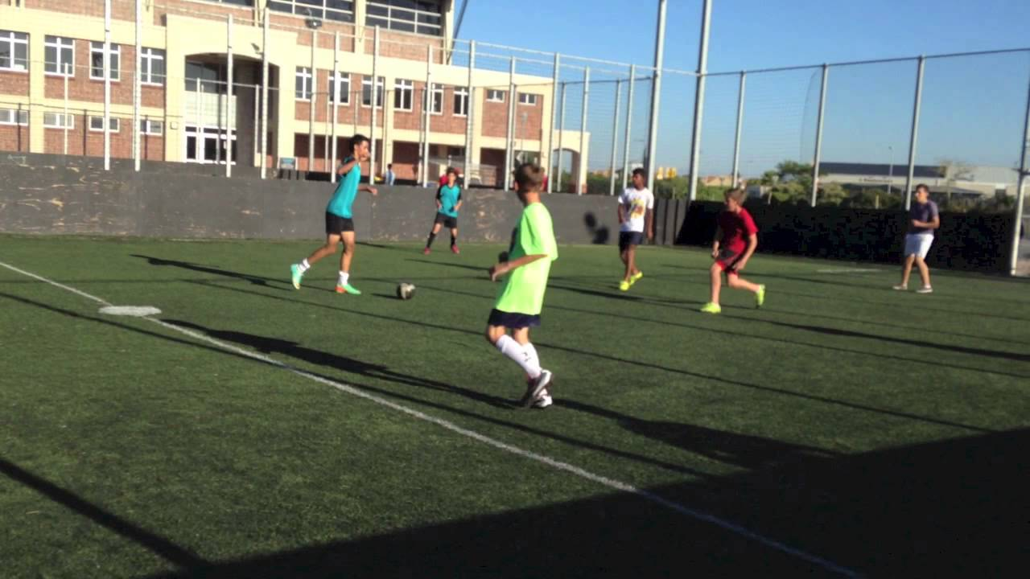
Sponsorships activations
Assist at National Team’s training
Meet & Greets
Get to play a 5 v 5 match with your NT Players.
Get to play FIFA20 with most-voted player and live streamed.

Slide 22
Digital strategy
Building an online community;
Be clear with what we ask ( if we ask for a cta or register);
People are motivated by opportunities to use and develop their skills;
Show and shout out appreciation;
All content to be shareable;
Create, tell, present stories;
Create daily engagement.

Slide 23
Communication plan
Pre-launch:
Posters and leaflets – simple, easy to read, reflecting the nature of the opportunities (display our materials in schools and colleges, sports centres, community buildings etc.);
Post Videos on Social Media with well-known and loved athletes talking about the project and highlight their appreciation for the work of volunteers;
Prepare a press kit;
Launch:
Live sessions on all social platforms from President FRF, Ministry - closer to a National Team home game;
Press release;
Post-launch:
Organize meetings in high schools and colleges, in as many towns as possible (promote the idea of ​​sport volunteering, its benefits and ​​the platform);
Ask for feedback and how can the app be improved.

Slide 24
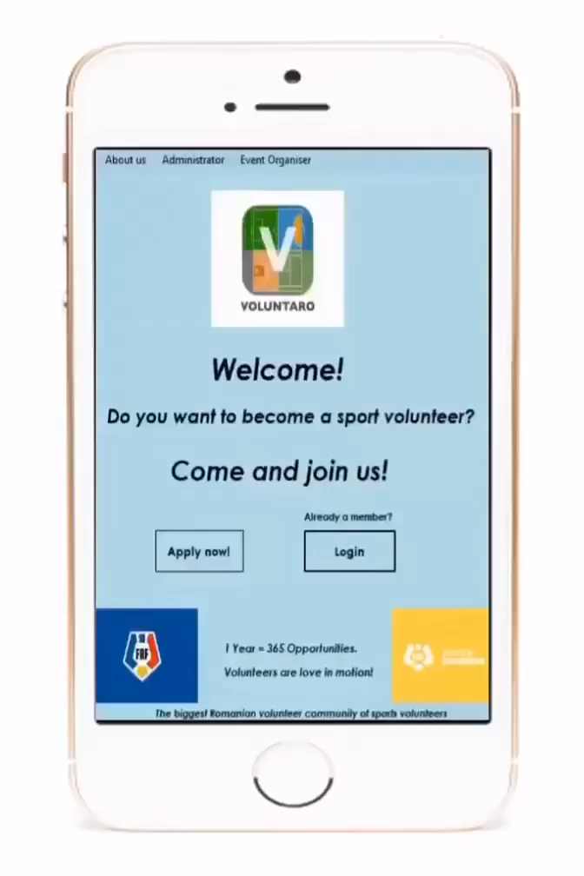
How does it work?
Customer journey

Slide 25

Social impact (sustainability)
Creating a community
Encouraging people to attend sport events
Development of other sports in Romania (not the ones with major impact on stadiums, polyvalent halls or TV)
Promoting a healthy lifestyle for people of all ages
Volunteering in sports can help public institutions and lead to better organisation
Digitalization of the processes (paper-less operations)
Equal opportunity for everyone to get involved

Slide 26
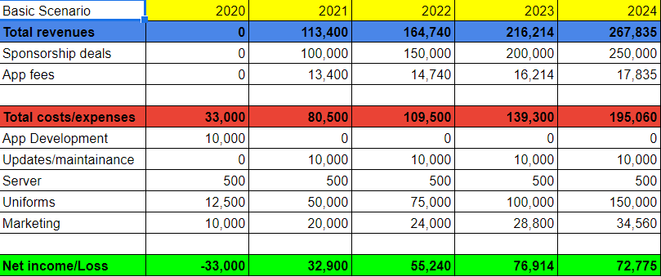
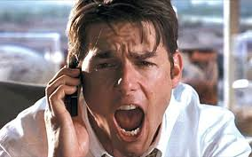
Financial Plan
Basic scenario
Show me the Money!!!

Slide 27
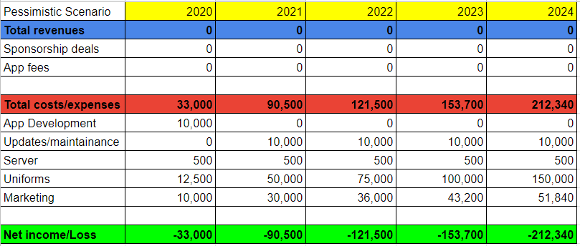
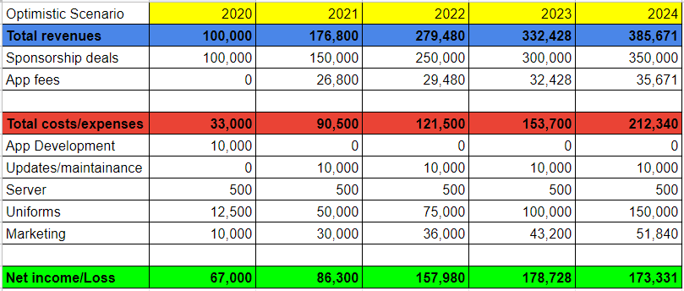
Pessimistic scenario
Optimistic scenario

Slide 28

Conclusion
VoluntaRO:
is first platform for the sports volunteers operating on national level;
attracts, develops and retain future volunteers and leaders;
is an opportunity to reward every single volunteer throughout the country for their hard work and dedication;
creates opportunities for brands to align with a meaningful movement.
connects people of all ages, genders, religions and nationalities.
So...

Slide 29

THANK YOU FOR YOUR ATTENTION!
ARE YOU READY?
LET’S SIGN-UP!

